Slide 1


AI mentoring workshop
Feb 2022

Slide 2
Introductions

Slide 3
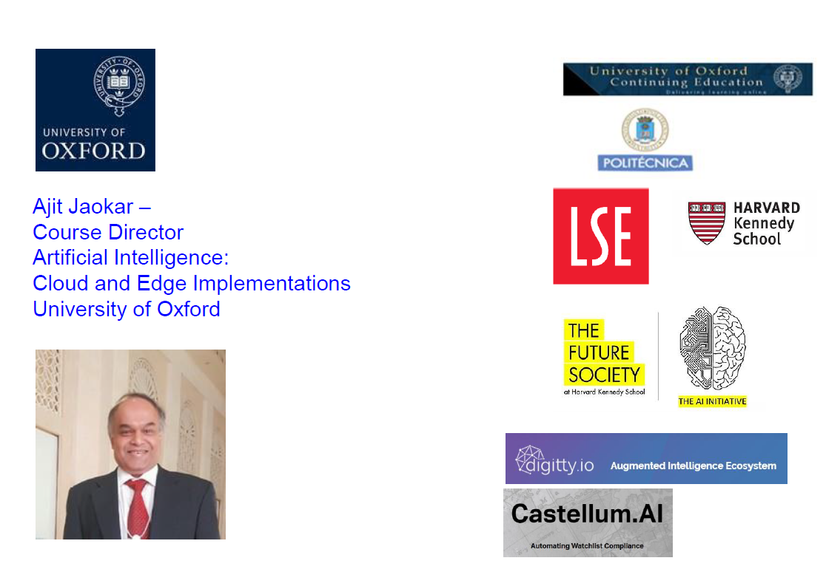
https://www.linkedin.com/in/ajitjaokar/

Slide 4



Course development team
Ayse Mutlu
Marina Fernandez
Kaouter Karboub

Slide 5
join slack group (link below)
https://join.slack.com/t/aimentoringworkshop/shared_invite/zt-121p9hntz-2zbfKpoyoxpuGWnv0jFpQA

Slide 6
Background material and community
All materials and code in the resources channel on slack
All questions to tutors in the ‘questions for tutors’ channel on slack

Slide 7
logistics
1) language of communication will be English
2) many participants from Garje Marathi
3) However, the core team supporting me is from Oxford so based in UK and Europe (and are not from Indian background)
so English works best - but I will explain in marathi if anyone wants
4) This is a charity/social venture - so there is no cost
5) Code we will use follows this week onwards
6) Sessions will be recorded
7) Videos will be accessed in a password protected site externally also

Slide 8
Some terms and considerations
If you are under 18, please let me know. We can still include you but we need to know this
Normal decorum and consideration apply. There are different levels of skills in the group and we want to create a supportive learning atmosphere for everyone
This is a complex topic - we have considerable experience teaching it and we have worked as a team before - so we aim to be supportive to the group and create a good learning atmosphere for all
This is an immersive course – try and spend as much time as possible over next 8 weeks

Slide 9
d) In many ways, questions are the answer i.e. the questions you ask are valuable. The primary mode of asking questions is in slack and / or in the live session
We aim to answer all questions in a week. There is no such thing as a silly qs. I may nominate someone in class to cross post questions in slack so we can keep track. volunteers welcome for this
e) This is part of a social venture and is not associated with any institution / company I am associated with (specifically not associated with Oxford even if 3 or 4 core team are from my Oxford course)

Slide 10
f) you consent to being recorded and the recording shared in a password protected site (not downloadable). The site will not charge participants to access the material
g) We are supportive for diversity and also female participation in learning to code.
Our core team has a good gender balance with three female leaders (of whom one is a PhD in AI, and two teach at Oxford with me)
h) There will be a book based on the code which we can share with you later if you are interested
Go slow first and speed up later so we get feel of group
j) Exact sequence by next week

Slide 11
Core team
Ajit Jaokar - Course Director - Artificial Intelligence - Cloud and Edge Implementations University of Oxford
Ayse Mutlu - Part of core team leading all development - Artificial Intelligence - Cloud and Edge Implementations University of Oxford
Marina Fernandez - Part of core team leading architecture / maths - Artificial Intelligence - Cloud and Edge Implementations University of Oxford
kaouter karboub PhD Artificial Intelligence - France

Slide 12
Supported by
Alexa Mc Mahon
Aditya Jaokar
Aaditya Bhaskaran
Malhar Bhide

Slide 13
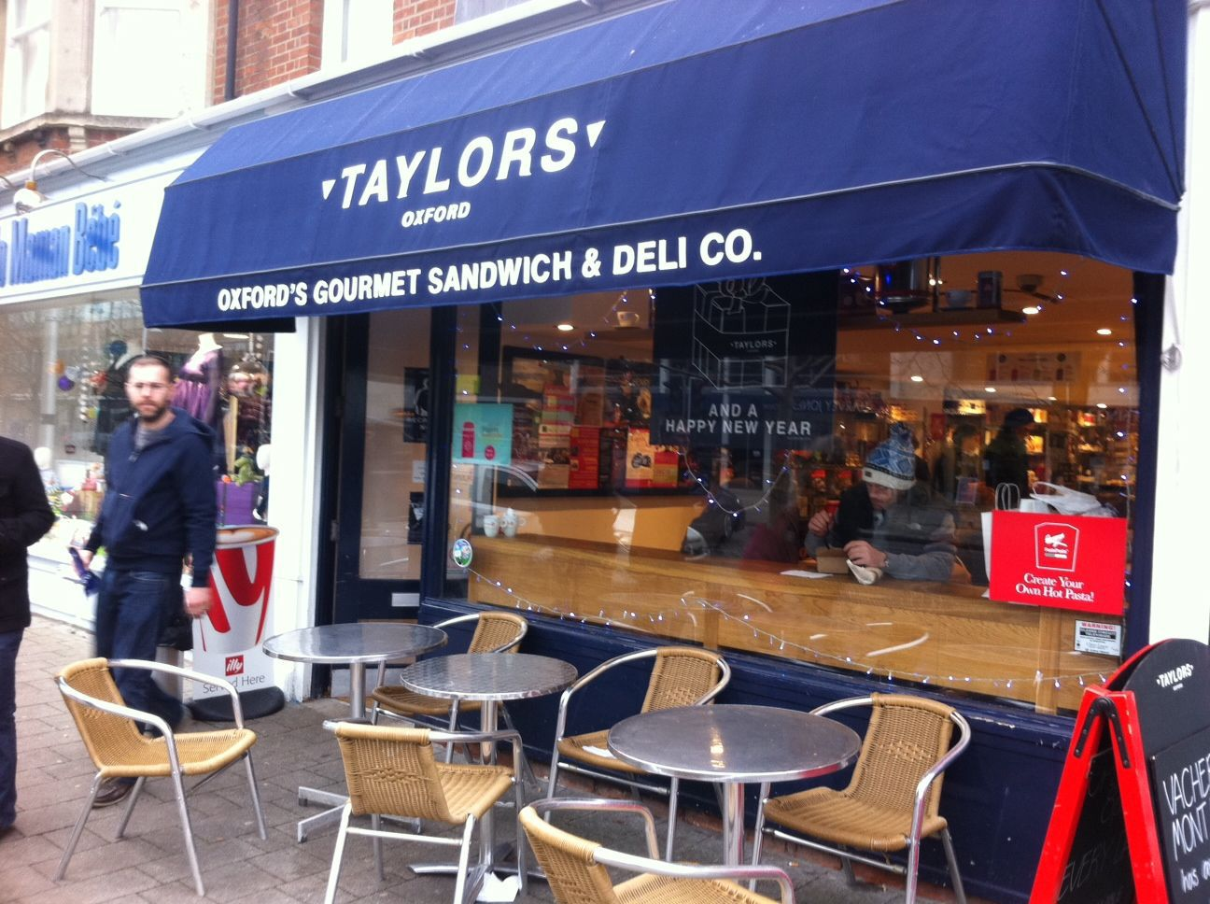

Slide 14
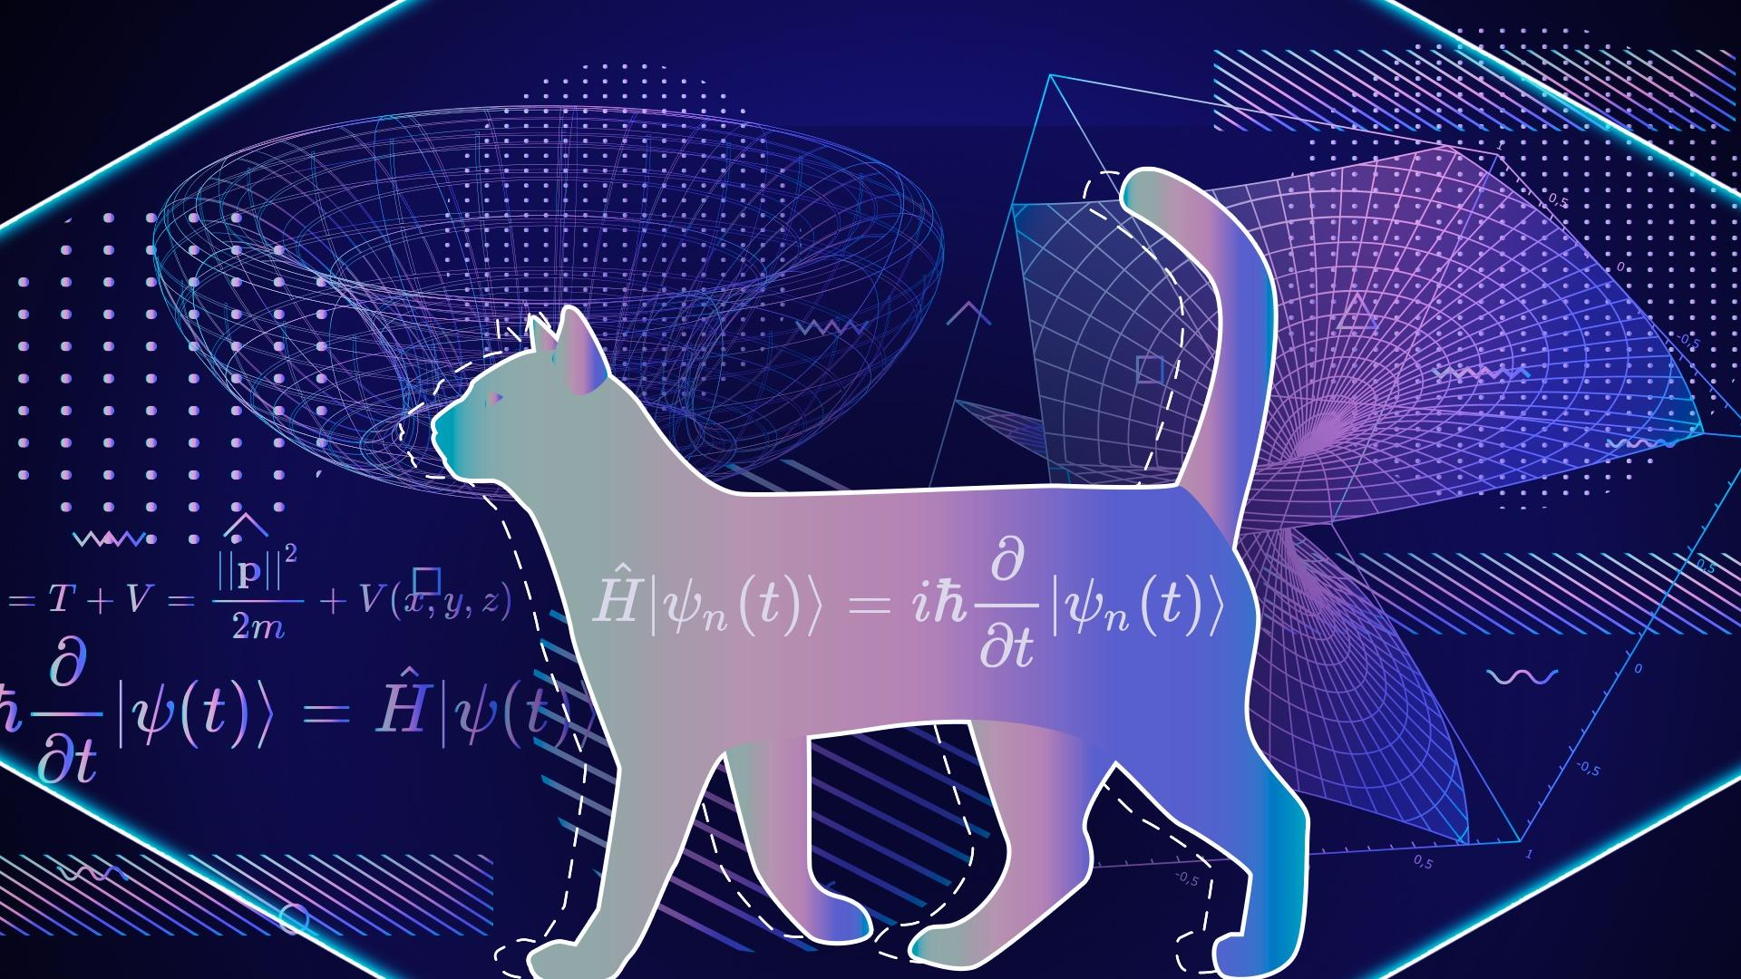

Slide 15


Slide 16
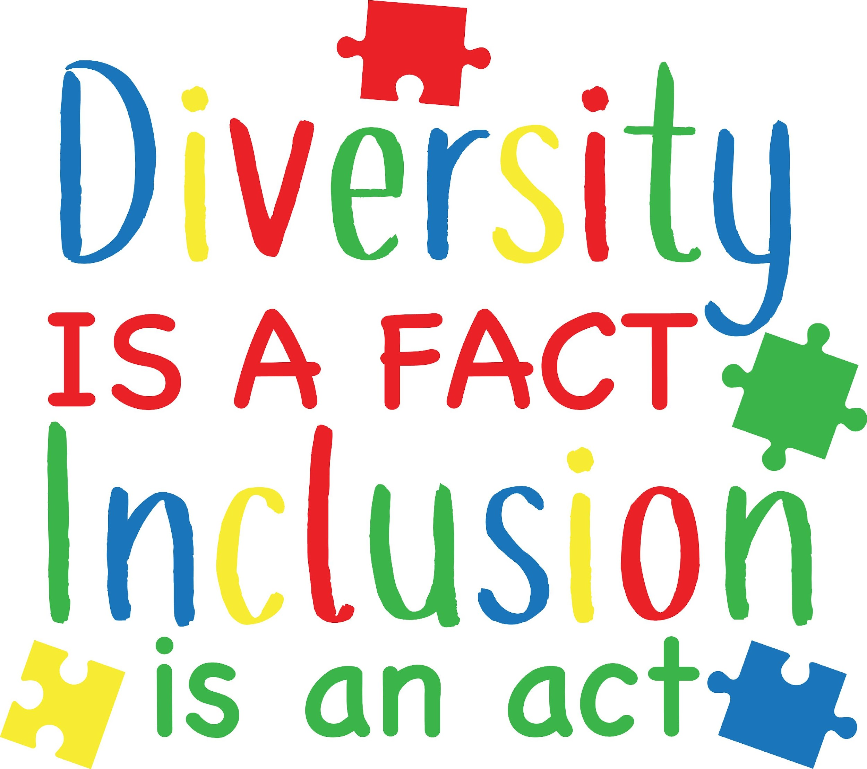
Diversity of learning: Supporting everyone in their individual learning journeys and recognising differences
Sharing personal experiences in AI with the participants

Slide 17

This is a complex subject. Communication online is very important in a learning setting. Always come back to us for any questions / help esp. to the core team i.e. me, Anjali, Amita, Ayse and Marina. Logistics issues – Jack.

Slide 18
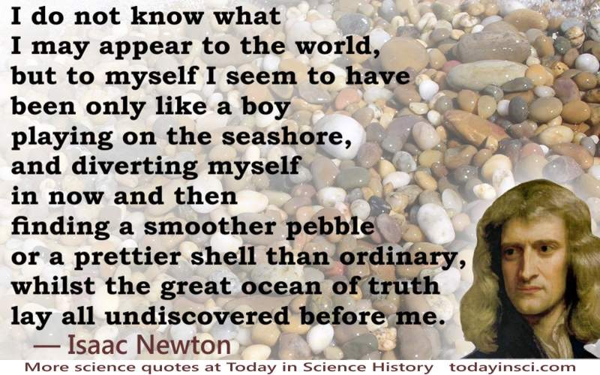

Slide 19

Source: eBay

Slide 20

Machine learning vs Deep Learning vs AI
Broadly …
Machine Learning = Explicitly training an algorithm
Deep Learning = Automatic feature detection
AI = Machines that can think and Reason (based on mainly Deep Learning algorithms)
Narrow AI = what we see today – i.e. AI in context of a specific problem
General AI = We don’t see today.
AI in context of any situation.
Like the Terminator movie!

Slide 21
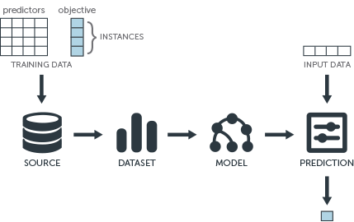

Slide 22
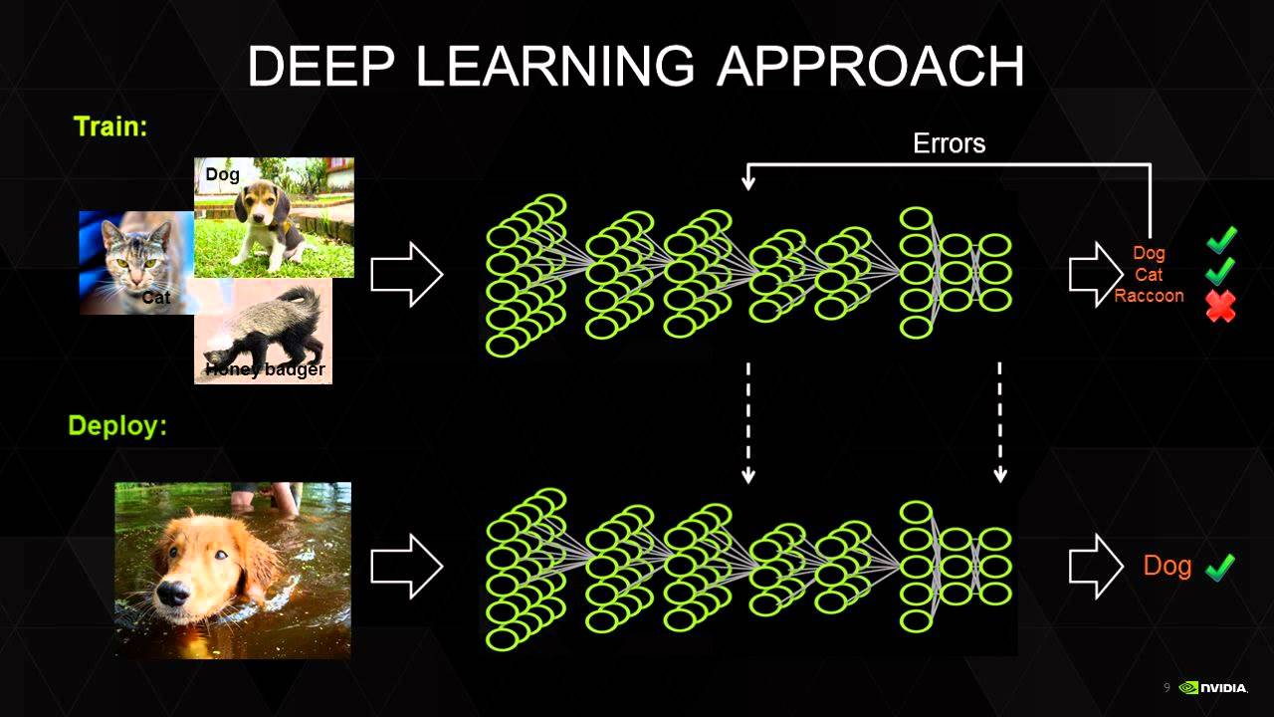
https://blogs.nvidia.com/blog/2018/07/20/intern-expands-horizons-deep-learning-institute/

Slide 23
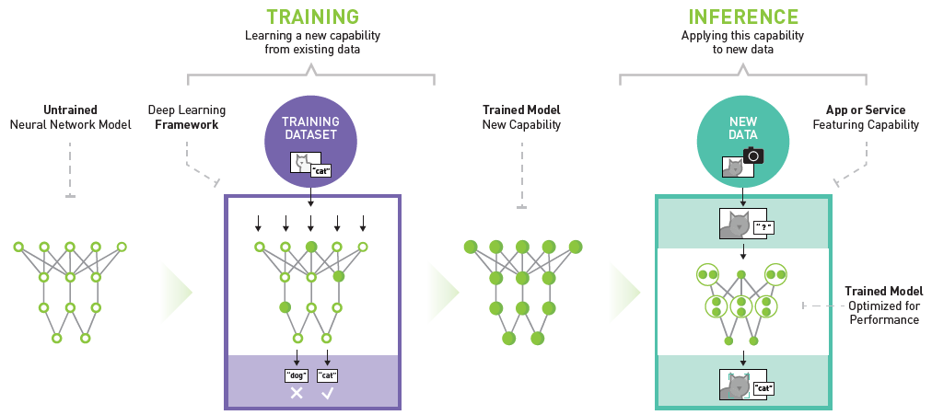
https://news.developer.nvidia.com/nvidia-deep-learning-inference-platform-performance-study/

Slide 24
AI – ML and DL - Basic concepts

Slide 25
Edge
AL/ ML
Cloud Native

Slide 26
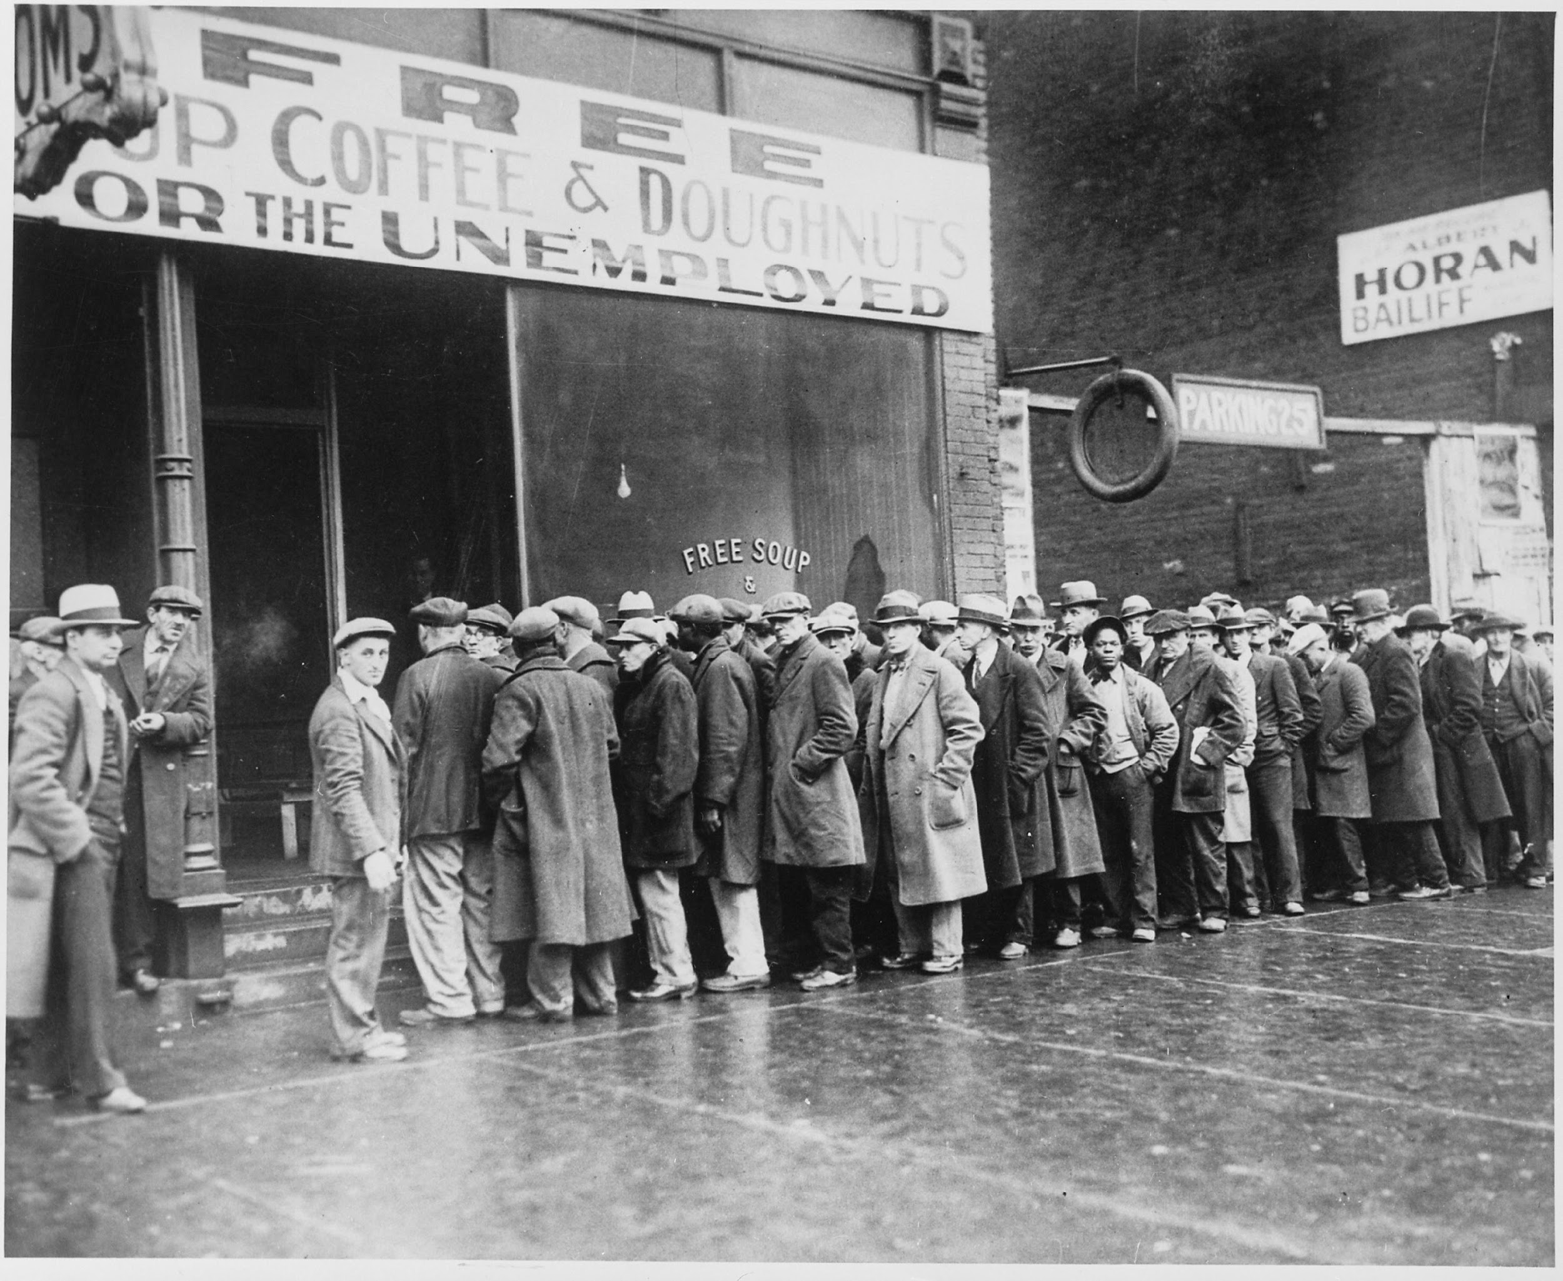
Image source: Wikipedia

Slide 27

Image source: wikipedia

Slide 28
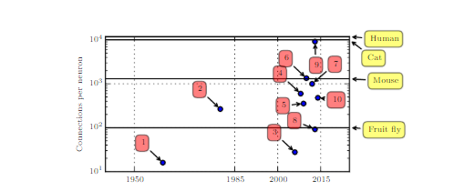

Slide 29
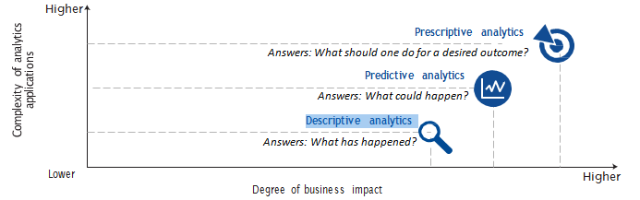

Slide 30
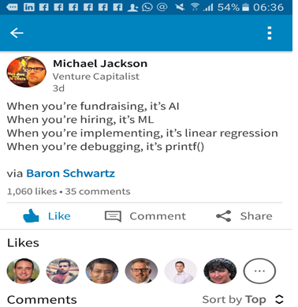

Slide 31

Image source: https://towardsdatascience.com/no-machine-learning-is-not-just-glorified-statistics-26d3952234e3

Slide 32
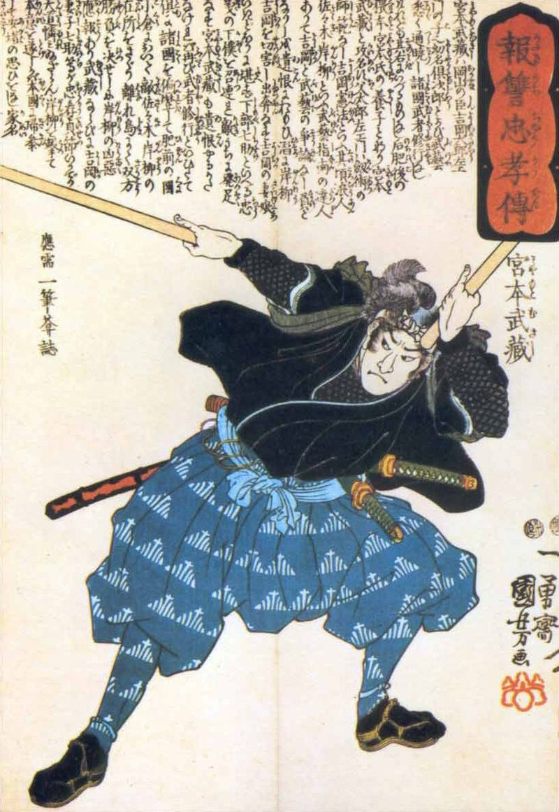
Image source: Wikipedia

Slide 33
Machine learning vs Deep Learning vs AI
Broadly …
Machine Learning = Explicitly training an algorithm
Deep Learning = Automatic feature detection(representation learning)
AI = Machines that can think and Reason (based on mainly Deep Learning algorithms)

Slide 34
When to use machine learning/deep learning?
The problem is very large
The problem is open ended
The problem changes
The problem is hard
The problem has ‘hidden rules’
The problem has hierarchical rules
The problem has many variants around a core
The problem is generative
Adapted from Thinking like a Machine Learning Architect
http://blog.intelligentsystem.io/2020/04/thinking-like-a-machine-learning-architect/

Slide 35
Traditional
Programming
data
outcomes
rules
data
Machine
Learning
rules
Outcomes

Slide 36
Working Problems Like a Data Scientist
OSEMN Process (Hilary Mason and Chris Wiggins)
Obtain Data : ex JSON and scripting languages
Scrub Data
Explore Data: “Explore” refers to exploratory data analysis (aka: no hypothesis that is being tested and no predictions that are being evaluated).
Command Line Tools
Histograms
Dimensionality Reduction Methods
Clustering to expose natural groupings in the data

Slide 37
Model Data (machine learning stage): Here, we apply the predictive models (regression, classification etc.). A model’s predictive accuracy can be evaluated by how well it performs on unseen data.
Interpret Results: In contrast to prediction which can be evaluated quantitatively, whereas interpretation is softer and qualitative and often visual.

Slide 38
Image source: https://www.bbvaapimarket.com/en/api-world/apis-and-machine-learning-how-predict-companys-success/

Slide 39
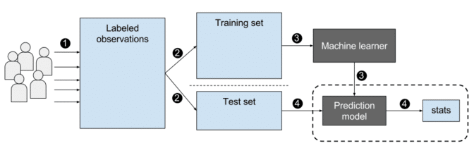
A more detailed overview of the general process:
Image source: https://blogs.nvidia.com/blog/2018/08/02/supervised-unsupervised-learning/

Slide 40
Statistical techniques
linear algebra basic statistics linear and logistic regression data mining predictive modelling cluster analysis association rules | market basket analysis decision trees time-series analysis forecasting machine learning Bayesian and Monte Carlo Statistics matrix operations sampling | text analytics summarization classification primary components analysis experimental design unsupervised learning constrained optimization

Slide 41
Computer science
Columnar databases Analytic accelerators Hadoop/ MapReduce NoSQL engines Stream computing In-memory analysis | Workload optimization Scripting and development tools Complex event processing Information integration Scalable storage infrastructure High-capacity warehouse | Visualization – Data Discovery Cloud infrastructure for Analytics Amazon Elastic Map Reduce Google BigTable

Slide 42
Data formats
Image
Video
Text
Time series
Audio

Slide 43
Modalities
Cloud
Edge
DevOps / MLOps/ CI-CD

Slide 44
Machine learning

Slide 45
Machine learning vs Deep Learning vs AI
Broadly …
Machine Learning = Explicitly training an algorithm
Deep Learning = Automatic feature detection (representation learning)
AI = Machines that can think and Reason (based on mainly Deep Learning algorithms)

Slide 46
WHAT IS MACHINE LEARNING?
Mitchell’s Machine Learning
“The field of machine learning is concerned with the question of how to construct computer programs that automatically improve with experience.”
v
Formally
“A computer program is said to learn from experience (E) with respect to some class of tasks (T), and performance measure (P), if its performance at tasks in T, as measured by P, improves with experience (E).”

Slide 47
FROM A PROGRAMMERS PERSPECTIVE
Think of it as a design tool used to understand:
What data we collect for the experience (E), what decisions the software needs to make (T), and how we evaluate the results (P).
Machine Learning involves:
Training of a model from data
Predicts/Extrapolate a decision
Against a performance measure.

Slide 48
Types of Problems
Classification: Data is labelled, (assigned a class); for example spam/non­spam or fraud/non­fraud. Decision – assign labels to a new type of data
Regression: Data is labelled with a real value rather than a label. Decision -relationship between inputs and outputs.
Clustering: Data is not labelled, but can be divided into groups based on similarity and other measures of natural structure in the data. Decision – organizing into groups
Rule Extraction: Decision - extraction of propositional rules (antecedent/consequent or if then).

Slide 49
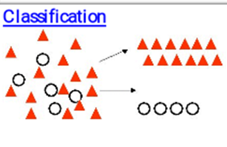
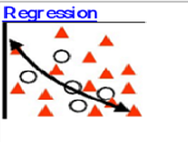
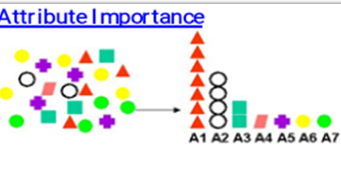
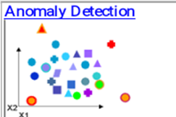
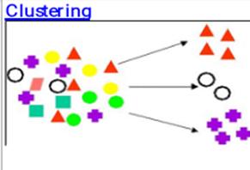
Image source: adapted from Oracle

Slide 50
The Learning in Machine Learning

Slide 51
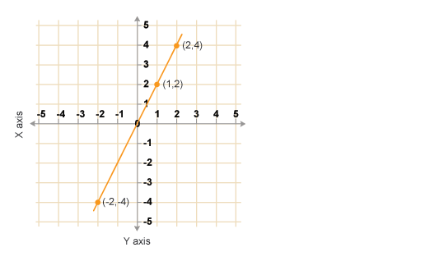

Slide 52
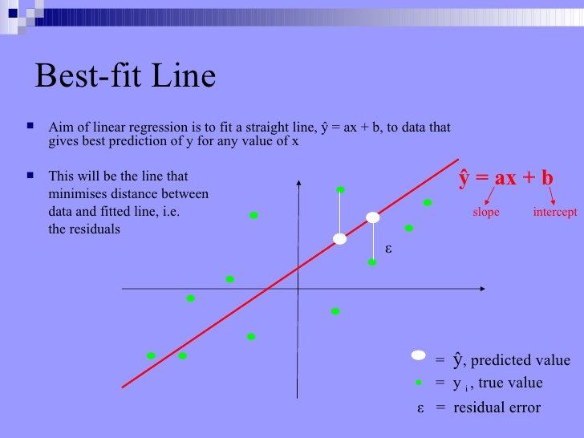
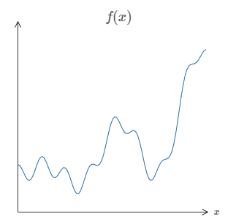

Slide 53
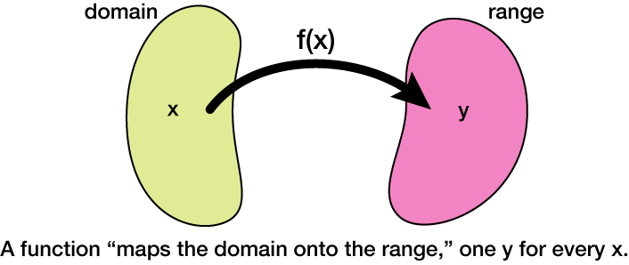
Our job is the find this function …
http://xaktly.com/MathFunctions.html

Slide 54
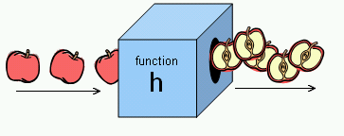
https://upload.wikimedia.org/wikipedia/commons/b/b8/Apple_slicing_function.png

Slide 55
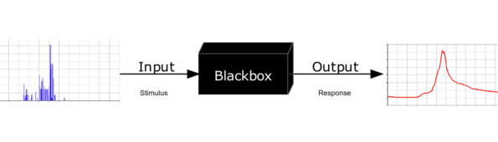
https://en.wikipedia.org/wiki/Black_box

Slide 56
Simplify
Real World Problem
Real Model
Interpret
Abstract
Conclusions
Mathematical Model
Calculate
Simulate
Program
Machine Learning
Adapted from http://www.indiana.edu/~hmathmod/modelmodel.html

Slide 57
Algorithms and Problem solving

Slide 58
Categorization of Algorithms
By learning style.
By similarity in form or function

Slide 59
Algorithms Grouped by Learning Style
1. Supervised Learning
Supervised Learning Algorithms - Input data has a label.
A model is prepared through a training process which continues till a desired level of accuracy is obtained on the training data. Examples: classification and regression. Example algorithm: Logistic Regression

Slide 60
2. Unsupervised Learning
Unsupervised Learning Algorithms: Input data is not labeled. Model building involves understanding the underlying structure for the data. Examples: clustering, dimensionality reduction and association rule learning. Example algorithms: K-Means.

Slide 61
Anomaly detection: Ex - Banks detect fraudulent transactions by looking for outlier patterns. Unsupervised learning is used in fraud detection because the malicious cases are very few and it’s not possible to train an algorithm on them (ex very few fraud cases vs non-fraud cases)

Slide 62
3. Semi-Supervised Learning
Semi-supervised Learning Algorithms: Input data is a mixture of labeled and unlabeled examples. Ex generative models.

Slide 63
Algorithms Grouped By Similarity
Algorithms are often grouped by similarity in terms of their function (how they work). For example, tree-based methods, and neural network inspired methods.

Slide 64
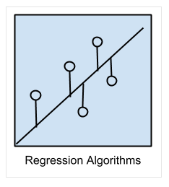
Regression Algorithms
Regression Algorithms: modelling a relationship between variables. Examples: Ordinary Least Squares Regression (OLSR), Linear Regression
Image source: Jason brownlee

Slide 65
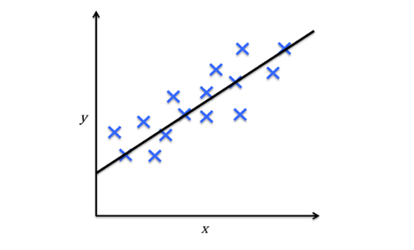
Regression
Image source: https://towardsdatascience.com/machine-learning-introduction-a-comprehensive-guide-af6712cf68a3

Slide 66
Classification Algorithms
Ex SVM, Logistic regression etc.
Image source: Jason brownlee

Slide 67
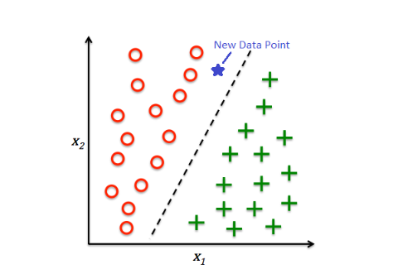
Image source: https://towardsdatascience.com/machine-learning-introduction-a-comprehensive-guide-af6712cf68a3

Slide 68
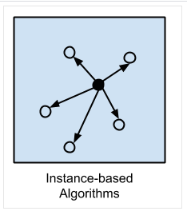
Instance-based Algorithms
Creates a similarity measure from example data and then compare a new instance to the measure based on the similarity measure. The most popular instance-based algorithms are: k-Nearest Neighbor (kNN)
Image source: Jason brownlee

Slide 69
Regularization Algorithms
Regularization Algorithms: Typically extend regression methods) that penalizes models based on their complexity, favoring simpler models that are also better at generalizing.

Slide 70
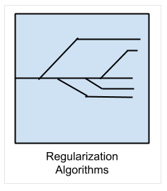
The most popular regularization algorithms are:
Ridge Regression
Least Absolute Shrinkage and Selection Operator (LASSO)
Elastic Net
Least-Angle Regression (LARS)
Image source: Jason brownlee

Slide 71
Decision Tree Algorithms
Decisions fork in tree structures until a prediction decision is made for a given record. Decision trees are often fast and accurate

Slide 72
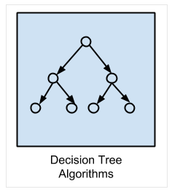
The most popular decision tree algorithms are:
Classification and Regression Tree (CART)
Image source: Jason brownlee

Slide 73
Bayesian Algorithms
Bayesian Algorithms: Apply Bayes’ Theorem for problems such as classification and regression.

Slide 74
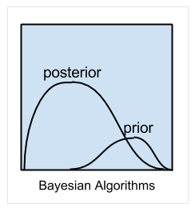
An example of Bayesian algorithm
Naive Bayes
Image source: Jason brownlee

Slide 75
Clustering Algorithms
Clustering Algorithms are concerned with using the inherent structures in the data to best organize the data into groups of maximum commonality.

Slide 76
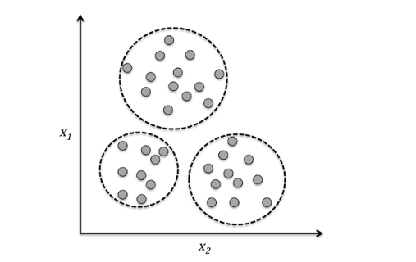
Clustering:
Image source: https://towardsdatascience.com/machine-learning-introduction-a-comprehensive-guide-af6712cf68a3

Slide 77
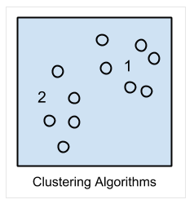
Example of Clustering algorithms:
k-Means
Image source: Jason brownlee

Slide 78
Association Rule Learning Algorithms
Association Rule Learning methods extract rules that best explain observed relationships between variables in data. These rules can discover important and commercially useful associations in large multidimensional datasets that can be exploited by an organization.

Slide 79
Association rules: {onions,potatoes} - {burger} – market basket analysis
- Web usage mining, intrusion detection, continuous
production, and bioinformatics. In contrast with

Slide 80
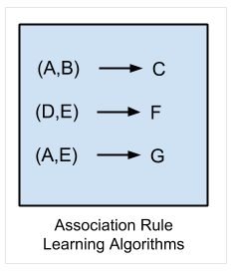
The most popular association rule learning algorithms are:
Apriori algorithm
Eclat algorithm
Image source: Jason brownlee

Slide 81
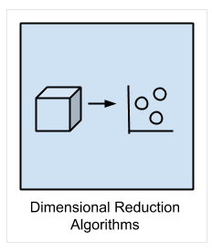
Dimensionality Reduction Algorithms
Dimensional Reduction Algorithms - exploit the inherent structure in the data to summarize or describe the data using less information. This can then be used to in supervised learning method.
Image source: Jason brownlee

Slide 82
Dimensionality Reduction:
Typically, each observation comes with a high number of features (high dimensionality). This can be a challenge because of sparse matrices and computational performance. Hence, we need dimensionality reduction.
Dimensionality reduction finds correlations between features, which could represent redundant information because some features could be partially explained with the other features.

Slide 83
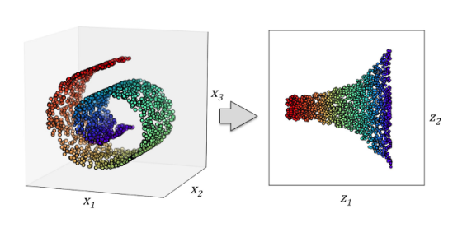
Image source: https://towardsdatascience.com/machine-learning-introduction-a-comprehensive-guide-af6712cf68a3

Slide 84
Ensemble Algorithms
Ensemble methods are models composed of multiple weaker models that are independently trained and whose predictions are combined in some way to make the overall prediction.

Slide 85
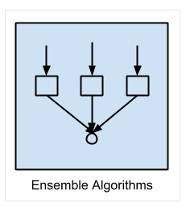
This is a very powerful class of techniques and as such is very popular.
Boosting
Bootstrapped Aggregation (Bagging)
Image source: Jason brownlee

Slide 86
ML/DL
Basic terminology and notations to get started

Slide 87
Basic Terminology and Notations
Each separate row of the matrix is a sample, observation or data point.
Each column is feature (or attribute) of that observation.
Usually there is one column (or feature), that we will call the target, label or response, and its the value or class that we’re trying to predict.

Slide 88
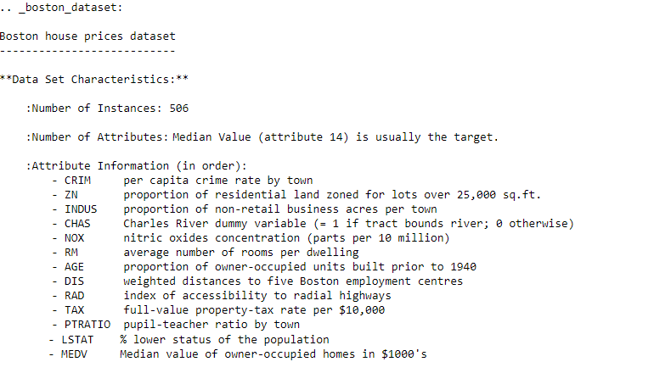

Slide 89
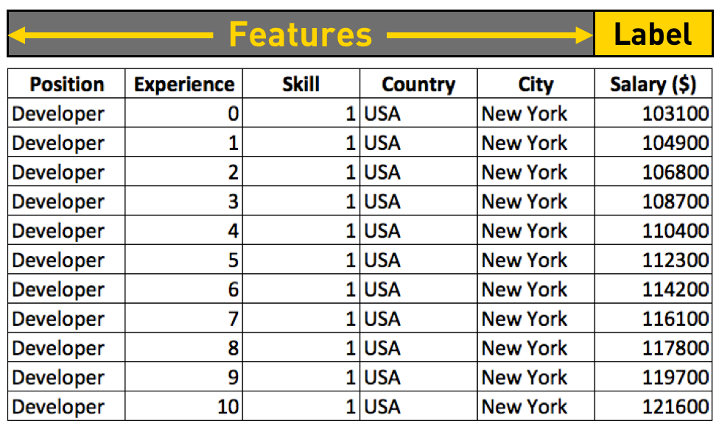
Image source: https://towardsdatascience.com/machine-learning-introduction-a-comprehensive-guide-af6712cf68a3

Slide 90
To train a machine learning model is to provide a machine learning algorithm with training data to learn from it.
machine learning algorithms usually have some other parameters. i.e.: In Decision Trees, there are parameters like depth, number of nodes, number of leaves… These are called hyperparameters.
Generalization is the ability of the model to make predictions on new data.

Slide 91
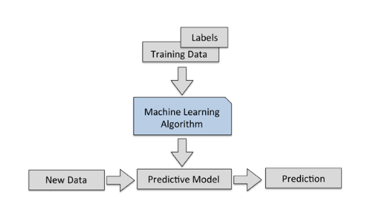
An overview of the general process:
Image source: https://towardsdatascience.com/machine-learning-introduction-a-comprehensive-guide-af6712cf68a3

Slide 92
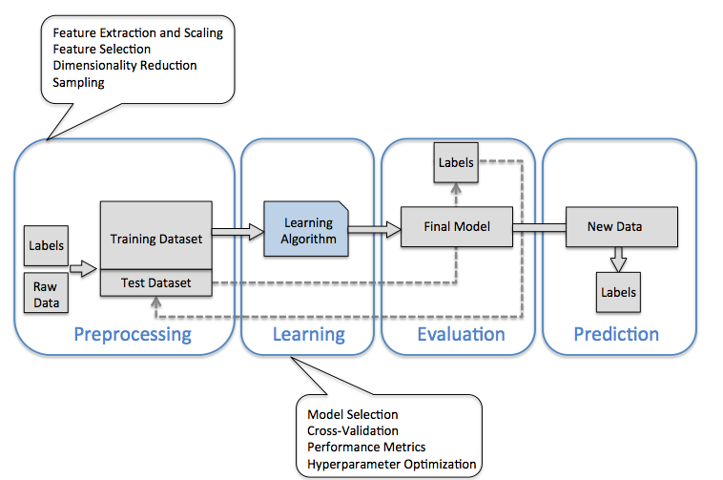
A more detailed overview of the general process:
Image source: https://towardsdatascience.com/machine-learning-introduction-a-comprehensive-guide-af6712cf68a3

Slide 93
Deep Learning algorithms

Slide 94
Artificial Neural Network Algorithms
Artificial Neural Network Algorithms: inspired by the structure and/or function of biological neural networks. Are also the basis of Deep Learning networks

Slide 95
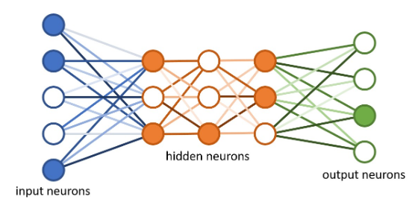
Deep Learning
Image source: https://towardsdatascience.com/machine-learning-introduction-a-comprehensive-guide-af6712cf68a3

Slide 96
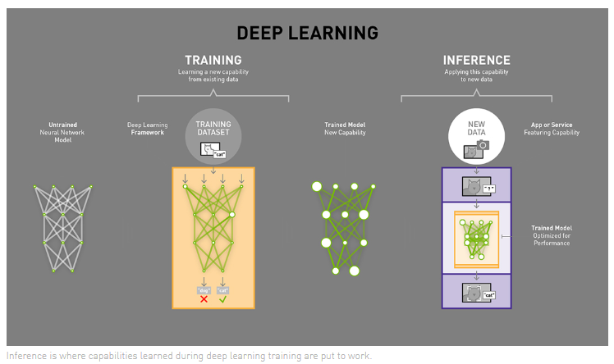
Image source https://blogs.nvidia.com/blog/2016/08/22/difference-deep-learning-training-inference-ai/

Slide 97
Autoencoders:
Autoencoders take input data
compress it then
try to recreate the input data from that compressed version
Ex: For a large novel like War and Peace –
Read the book
Create a summary
Then recreate the book based on summary
If the representation is smaller but still faithful to the original
you get a compressed version of the data.
You can also remove noise from the data.

Slide 98
Deep Learning

Slide 99
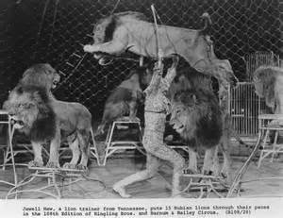
What is the best way to train ‘Big Data’ algorithms?
Training machines is a ‘hard’ problem ..

Slide 100
How to train an algorithm?
Start with the Rules and apply them to Data OR Start with the data and find the rules from the Data
The Top-down approach involved writing enough rules for all possible circumstances. But this approach is obviously limited by the number of rules and by its finite rules base.
Bottom up approach: where there are no rules :
No models(schema),
Linearity(sequence) and hierarchy is not known
Non deterministic – output is not known
Problem domain is not finite
In contrast – transactional computing is straight forward

Slide 101
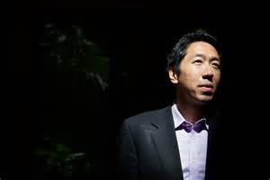
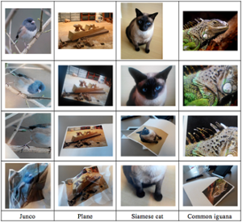
10 million images from YouTube videos – recognise pictures of Cats - without telling what a cat is
Apply them to real problems such as image recognition, search, and natural-language understanding,

Slide 102
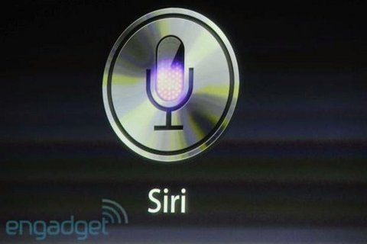
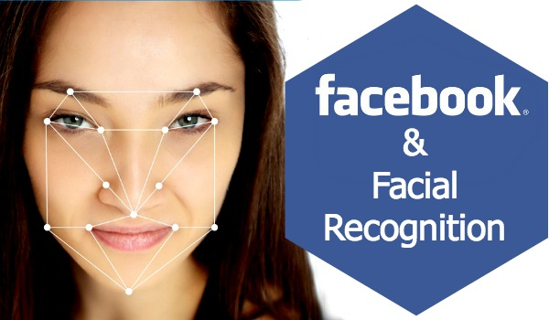

Slide 103
Big Data – training big Data
Siri and Facebook face recogniton
The idea here is to learn from experience. The experience was provided by ‘labelled data’. (Spam/No spam)
However, most data (pictures, video feeds, sounds, etc.) is not labelled and if it is, it’s not labelled well. the problem domain is not finite(there are infinite options)
Deep learning systems are possible to implement now because of three reasons: High CPU power, Better Algorithms and the availability of more data. Over the next few years, these factors will lead to more applications of Deep learning systems
They address problems that humans an find solutions to quickly – ex what is a cat .. Vs what is a dog .. But Computers cannot

Slide 104
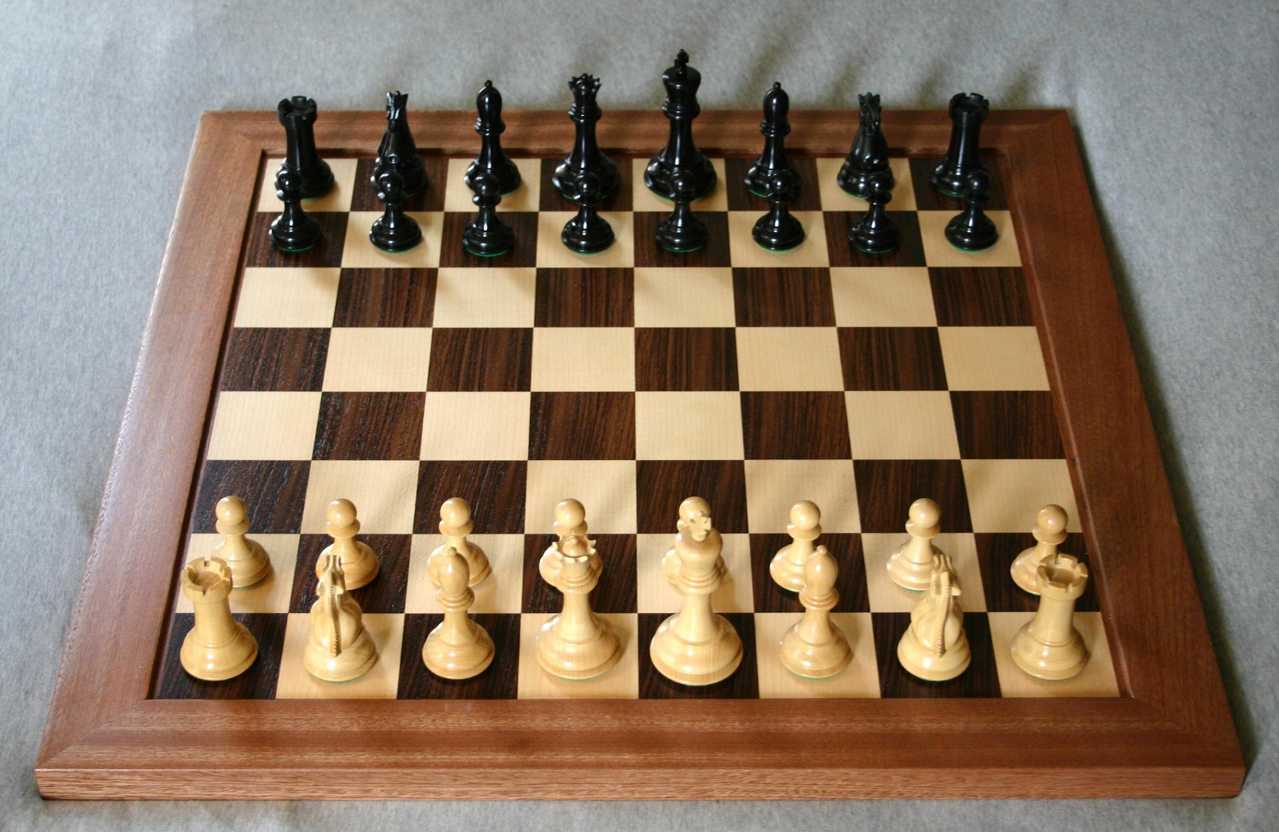

10 million images from YouTube videos – recognise pictures of Cats - without telling what a cat is
Apply them to real problems” such as image recognition, search, and natural-language understanding
Chess is a finite domain problem
Image source: https://www.nbcnews.com/health/kids-health/here-s-reason-get-puppy-kids-pets-have-less-anxiety-n469591 and chess (Wikipedia)

Slide 105
Chess vs. Cat: Second is very hard (for a Compuer) but is easy for a Child!
How does Deep Learning help to solve the intuitive problem
The whole objective of Deep Learning is to solve ‘intuitive’ problems i.e. problems characterized by High dimensionality and no rules.
Deep learning allows computers to solve intuitive problems because:
With Deep learning, Computers can learn from experience but also can understand the world in terms of a hierarchy of concepts – where each concept is defined in terms of simpler concepts.
The hierarchy of concepts is built ‘bottom up’ without predefined rules
This is similar to the way a child learns ‘what a dog is’ i.e. by understanding the sub-components of a concept ex the behavior(barking), shape of the head, the tail, the fur etc and then putting these concepts in one bigger idea i.e. the Dog itself.

Slide 106

Image and example source: Yoshua Bengio book – Deep Learning

Slide 107

A more detailed overview of the general process:
Image source: https://towardsdatascience.com/machine-learning-introduction-a-comprehensive-guide-af6712cf68a3

Slide 108


Slide 109
For example: From the pixels, the first hidden layer identifies the edges
From the edges, the second hidden layer identifies the corners and contours
From the corners and contours, the third hidden layer identifies the parts of objects
Finally, from the parts of objects, the fourth hidden layer identifies whole objects
Image and example source: Yoshua Bengio book – Deep Learning
Computers can be trained to recognize an object by showing labelled images of the object.
When a computer sees many images of the same object, it discerns a model of an object
When trained, the next time it sees an image of the object, it can identify the object

Slide 110


Where are these techniques being used
Detect malignant tumours
Pick out potentially useful drug molecules from hundreds of millions of candidates.

Slide 111

Once trained (features are selected), the input vectors are transformed into a better representation and these are in turn passed on to a real classifier such as SVM or Logistic regression. This can be represented as below.
Source: ELEG 5040 Advanced Topics on Signal Processing (Introduction to Deep Learning) by Xiaogang Wang

Slide 112

Deep Learning and Feature learning
Deep Learning can be hence seen as a more complete, hierarchical and a ‘bottom up’ way for feature extraction and without human intervention.
Source: ELEG 5040 Advanced Topics on Signal Processing (Introduction to Deep Learning) by Xiaogang Wang

Slide 113


Slide 114
Gesture Recognition
The ability to analyse human actions and extract real-time information from video streams. Applies to Robots, Fall Detection, In-car monitoring, Security
Voice Biometrics or Authentication
The ability to use voice as an authentication method and identify individual speakers with speech recognition. alternatively, use voice as the authentication method.

Slide 115
Machine vision
Used in robotics, face recognition, content moderation etc.
Video surveillance
Use of AI in images from surveillance camera - often on the Edge, i.e. at the device itself. as digital brains to match their eyes.
Handwriting Recognition
Recognise and extract handwritten text

Slide 116
Text recognition and generation
Generating text - i.e. transforming data into a written narrative
Entity Recognition
Detect objects in images
Natural Language Processing
Text analysis and the ability to extract information about people, places, events from text documents. Also includes sentiment analysis, context classification and language translation

Slide 117
Movement Prediction
Prediction of movement based on images
Creating images from text
The ability to create images from text
Attention, Sentiment Tracking
tracking of emotional response based on facial movement and other techniques.

Slide 118

Reinforcement Learning
Learning by trial and error
Image source: https://towardsdatascience.com/machine-learning-introduction-a-comprehensive-guide-af6712cf68a3

Slide 119
What Is Reinforcement Learning?
The AI agent is attempting to find the optimal way to accomplish a particular goal or improve performance on a specific task.
The agent takes action that goes toward the goal
it receives a reward.
The overall aim: predict the best next step to take to earn the biggest final reward.
This technique is especially useful for training robots, which make a series of decisions in tasks like steering an autonomous vehicle or managing inventory in a warehouse

Slide 120
Generative Adversarial Networks(GANs)
GANs are gaining in popularity recently. GANs belong to a set of algorithms called generative models. Typically, GANs are used in cases where we generate realistic data from a given sample – typically image data.

Slide 121

Image source https://medium.com/ml-everything/generating-letters-using-generative-adversarial-networks-gans-161b0be3c229

Slide 122
Generative Adversarial Networks are composed of two models: The Generator and the Discriminator. The analogy of a forger and an art expert is often used to illustrate how GANs work. The Generator acts like a human art forger which creates fake works of art. The discriminator serves as the art expert who tries to detect these counterfeit works. If the input data belongs to the original dataset it is deemed as ‘real' or else, it is generated (and hence fake)

Slide 123
GANs (Generative adversarial networks) are an example of semi supervised learning. Art forger and art expert
Consider two deep learning networks in competition – one generates data by mimicking the training data – the other detects if the data is fake or really part of the training data. Both networks improve in a positive feedback loop
The discriminator gets better at separating the fakes from the originals
The generator improves its ability to create convincing fakes.

Slide 124

After training, we discard the discriminator because we need the discriminator only for training the generator.
Source: https://towardsdatascience.com/semi-supervised-learning-with-gans-9f3cb128c5e

Slide 125

A more detailed overview of the general process:
https://blogs.nvidia.com/blog/2018/08/02/supervised-unsupervised-learning/

Slide 126
Types of AI problems
We now discuss the types of AI problems
1) Domain expert: Problems which involve Reasoning based on a complex body of knowledge
This includes tasks which are based on learning a body of knowledge like Legal, financial etc. and then formulating a process where the machine can simulate an expert in the field
2) Domain extension: Problems which involve extending a complex body of Knowledge
Here, the machine learns a complex body of knowledge like information about existing medication etc. and then can suggest new insights into the domain itself – for example, new drugs to cure diseases. (extend expert knowledge in the field)

Slide 127
3) Complex Planner: Tasks which involve Planning
Many logistics and scheduling tasks can be done by current (non-AI) algorithms. However, increasingly, as the optimisation becomes complex AI could help. One example is the use of AI techniques in IoT for Sparse datasets AI techniques help on this case because we have large and complex datasets where human beings cannot detect patterns, but a machine can do so easily.
4) Better communicator: Tasks which involve improving existing communication
AI and Deep Learning benefit many communication modes such as automatic translation, intelligent agents etc

Slide 128
5) New Perception: Tasks which involve Perception
AI and Deep Learning enable newer forms of Perception which allow new services such as autonomous vehicles
6) Digital transformation
While autonomous vehicles etc. get a lot of media attention, AI will be deployed in almost all sectors of the economy. In each case, the same principles apply, i.e. AI will be used to create new insights from automatic feature detection via Deep Learning - which in turn help to optimise, improve or change a business process (over and above what can be done with traditional machine learning).

Slide 129
7) Enterprise AI adding unstructured data and Cognitive capabilities to the Enterprise
Majority of the data available to most organisations is unstructured – call logs, emails, transcripts, video and audio data etc. AI can be used to gain insights from this information using techniques like CNNs
8) Problems which impact domains due to second order consequences of AI
‘Second-order consequences' cover the broader impact of changing a specific process through AI. For example, introducing AI in healthcare impacts insurance

Slide 130
9) Problems in the near future that could benefit from improved algorithms
A catch-all category for things which were not possible in the past could be possible in the near future due to better algorithms or better hardware. For example, in Speech recognition, improvements continue to be made and currently, the abilities of the machine equal that of a human.
10) Super Long sequence pattern recognition
The application of AI techniques to sequential pattern recognition ex genomics.

